Slide 1
GCP Lecture 4 PBR Part 1
Dr Leigh McLoughlin
lmcloughlin@bournemouth.ac.uk

Slide 2
Intro
PBR Schedule:
First lecture:
Intro – motivations, etc
Overview
Equations!
Why there are so many equations for the same thing
Second lecture:
Radiometry
Photometry
Camera
Lights
Sampling, Monte Carlo Integration

Slide 3
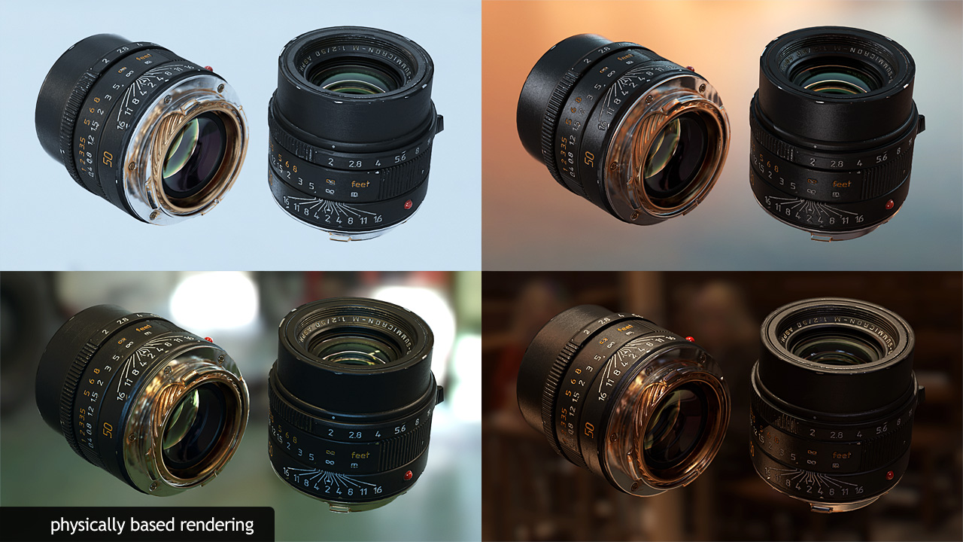
Intro
Physically Based Rendering
https://marmoset.co/posts/physically-based-rendering-and-you-can-too/

Slide 4
Intro
Brief Description
What is Physically Based Rendering?
A rendering approach that uses physics to more accurately mimic how light behaves in the real world, with the intention of producing results that are closer to their real-world equivalents
This means it’s heavily based on physics

Slide 5
Intro
Motivations
Why is PBR important to us for making games?
Search for realism
Offline techniques → real-time
Graphics has been heading towards PBR for some years, so it’s likely to be important if you want to make games in the future

Slide 6
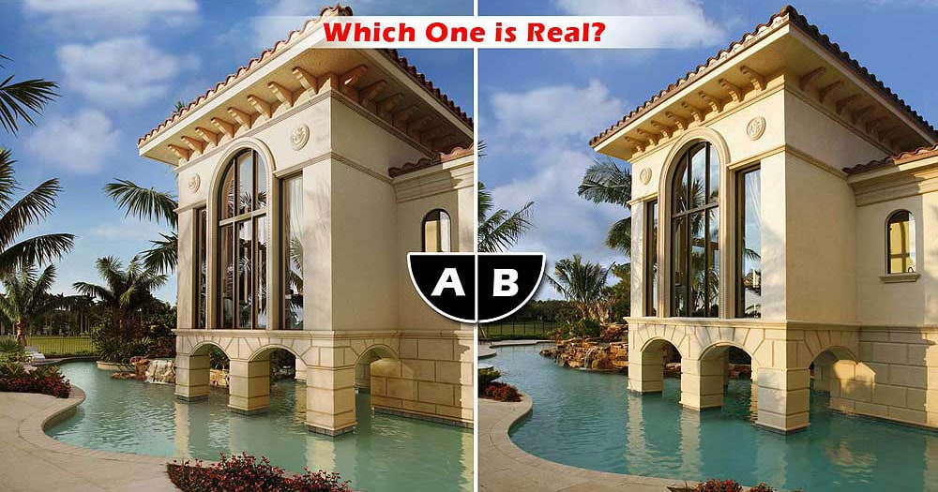
Intro
Motivations: The Quest for Photorealism
https://3das.com/photorealistic-3d-renderings/

Slide 7
Intro
Motivations
Ray-tracing and Real-time rendering
PBR first appeared in ray tracing
Many offline methods eventually become possible in real time
Hardware speed and memory increase
Hardware features increase – e.g. more complex shaders
Thus, looking at offline techniques is very important for us

Slide 8
Intro
Why is PBR important?
PBR is slower than ‘traditional’ rendering (e.g. Phong) and less flexible
But, PBR does have some key practical advantages:
More consistent and gives more reliable visuals
Can be easier for artists

Slide 9
Intro
Consistency and Reliability
Easier to move object assets from one environment to another:
Materials behave as expected in different lighting conditions without needing to be adjusted (which is sometimes needed in traditional approaches).
This gives a more standard approach and means assets can just be dropped into a scene much more easily.
Work from different artists is more consistent, great for team efforts

Slide 10
Intro
Artistic Use
Traditional shading heavily relies on artistic ability to mimic real-world materials, but PBR can make it easier for artists to achieve what they want
In PBR, artists set up materials and scenes more like they would in the real world

Slide 11
Intro
How does it affect artists?
It changes their workflow
They must produce different texture maps to what they’re used to
More emphasis on material selection and looking up real-world values than defining generic properties
PBR can be less intuitive – e.g. metals have zero diffuse and just defined by reflectance colour; what is the refractive index of a metal?

Slide 12
Intro
How does it affect artists?
Lights must have real-world values, so artists must learn these
New tools to learn are now available (e.g. substance painter)
No standards yet – do the tools fit the pipeline? Moving from engine to engine may require asset changes

Slide 13
Intro
Brief History
PBR started as an offline technique
Microfacets were explored in CG the 1980s
Ray tracing was an important complementary development (1980s)
Global illumination, especially Monte Carlo techniques (1990s)
Arguments were put forward by academics for basing renderings on measurements from the real-world
Mid 2000s, commercial renderers start moving towards PBR
2010s, films start appearing with more PBR pipelines (e.g. Gravity)
Mid 2010s, game engines start moving towards PBR
2019, you start learning about PBR :P

Slide 14
Intro
Resources
Some useful PBR resources:
http://www.pbr-book.org/3ed-2018/contents.html ← whole book!!
https://seblagarde.files.wordpress.com/2015/07/course_notes_moving_frostbite_to_pbr_v32.pdf ← real-time PBR in commercial engine
https://github.com/KhronosGroup/glTF-WebGL-PBR ←Source code!

Slide 15
Physically Based Rendering
Equations!
https://marmoset.co/posts/physically-based-rendering-and-you-can-too/

Slide 16
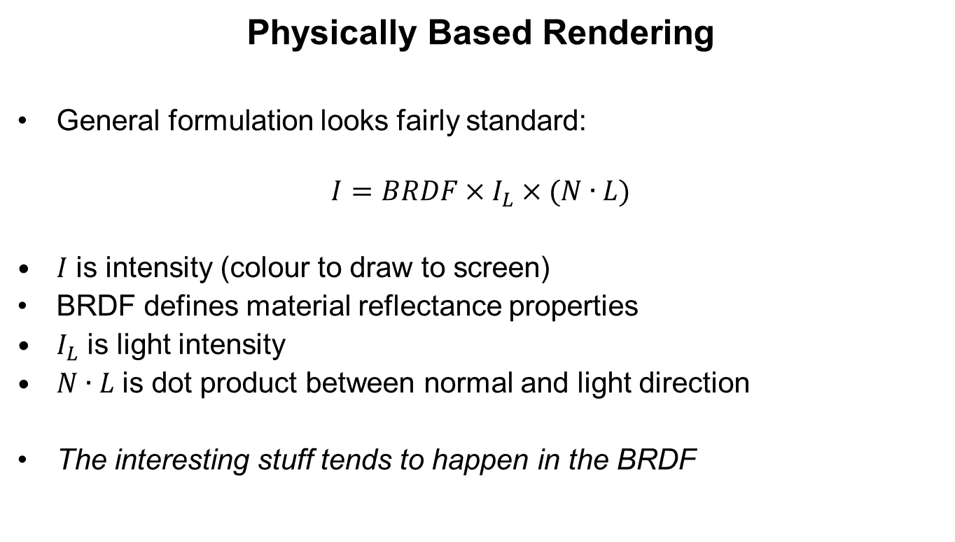
Physically Based Rendering
Physically Based Rendering
General formulation looks fairly standard:
$$I=BRDF×I_{L}×(N∙L)$$
$I$ is intensity (colour to draw to screen)
BRDF defines material reflectance properties
$I_{L}$ is light intensity
$N∙L$ is dot product between normal and light direction
The interesting stuff tends to happen in the BRDF

Slide 17
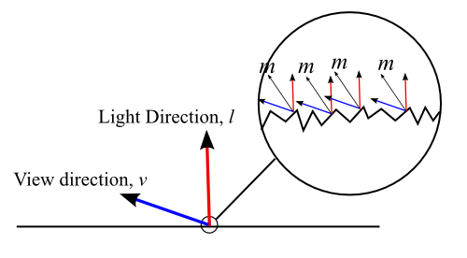
Physically Based Rendering
Physically Based Rendering
The BRDF in PBR tends to follow the Cook-Torrance approach:
Microfacets:
Surface is rough at sub-pixel scale
http://simonstechblog.blogspot.com/2011/12/microfacet-brdf.html

Slide 18
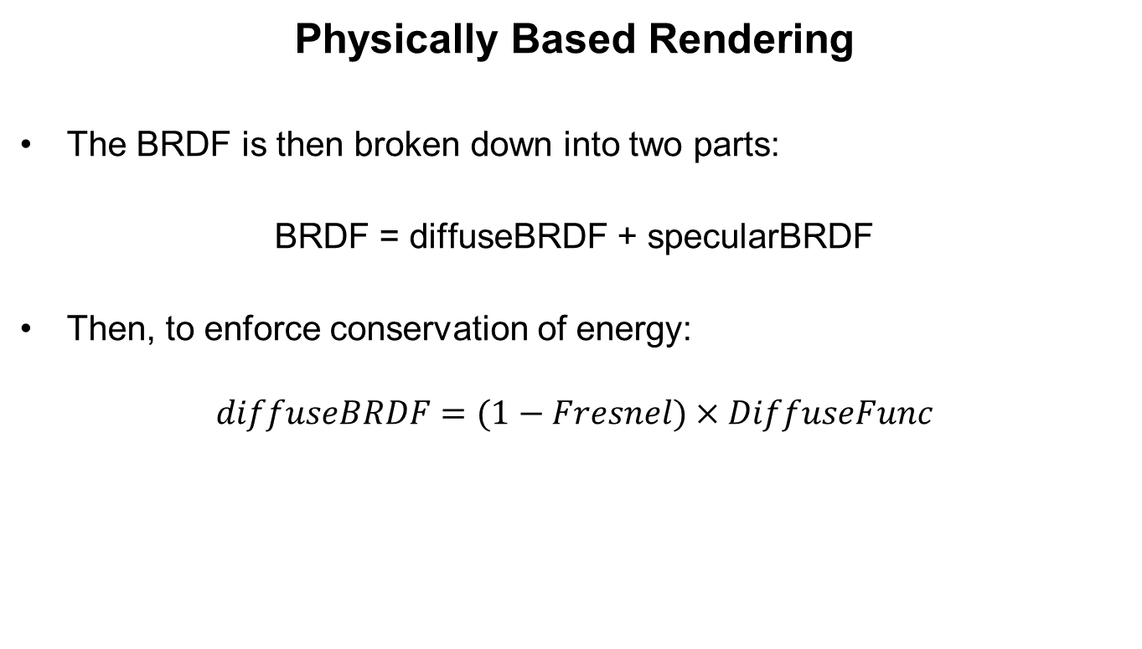
Physically Based Rendering
Physically Based Rendering
The BRDF is then broken down into two parts:
BRDF = diffuseBRDF + specularBRDF
Then, to enforce conservation of energy:
$$diffuseBRDF=(1−Fresnel)×DiffuseFunc$$

Slide 19
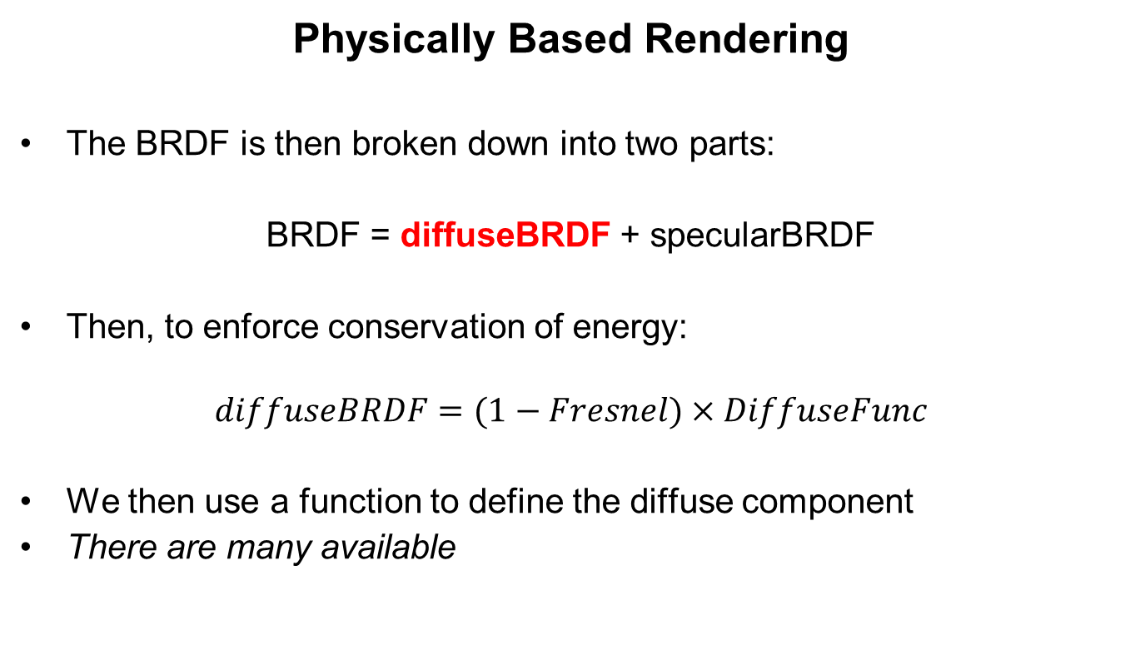
Physically Based Rendering
Physically Based Rendering
The BRDF is then broken down into two parts:
BRDF = diffuseBRDF + specularBRDF
Then, to enforce conservation of energy:
$$diffuseBRDF=(1−Fresnel)×DiffuseFunc$$
We then use a function to define the diffuse component
There are many available

Slide 20
Physically Based Rendering
PBR BRDF Diffuse Component
Lambert:
vec3 Diffuse_Lambert( vec3 albedo )
{
return albedo / PI;
}
Disney:
float Fr_DisneyDiffuse( float NdotV, float NdotL, float LdotH, float linearRoughness )
{
float energyBias = lerp(0.0 , 0.5 , linearRoughness );
float energyFactor = lerp(1.0 , 1.0 / 1.51 , linearRoughness );
float fd90 = energyBias + 2.0 * LdotH * LdotH * linearRoughness;
vec3 f0 = vec3(1.0 , 1.0 , 1.0);
float lightScatter = F_Schlick( f0 , fd90 , NdotL ).r;
float viewScatter = F_Schlick( f0 , fd90 , NdotV ).r;
return (lightScatter * viewScatter * energyFactor) / PI ;
}

Slide 21
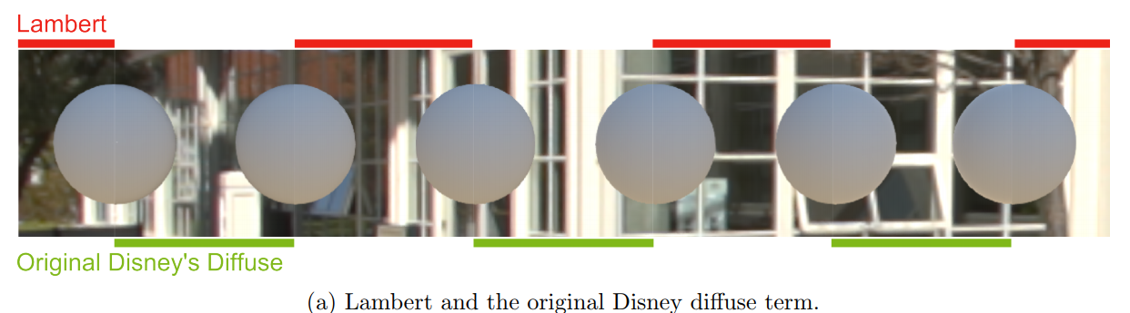
Physically Based Rendering
PBR BRDF Diffuse Component
Can you see the difference?
No, me neither ;)
There is a difference but it’s so subtle is it worth the effort?
There are others with slightly more noticeable differences though
https://seblagarde.files.wordpress.com/2015/07/course_notes_moving_frostbite_to_pbr_v32.pdf

Slide 22
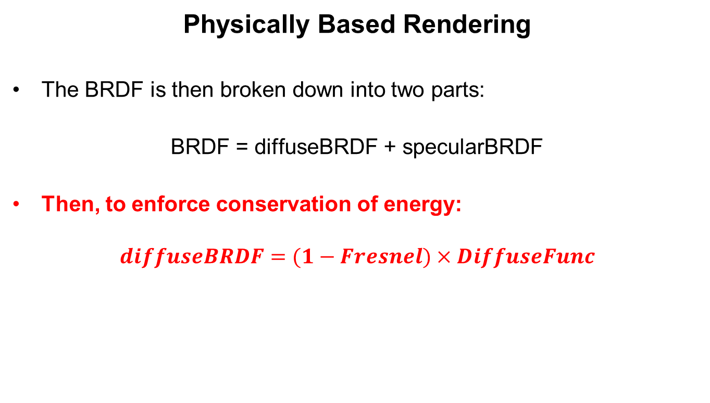
Physically Based Rendering
Physically Based Rendering
The BRDF is then broken down into two parts:
BRDF = diffuseBRDF + specularBRDF
Then, to enforce conservation of energy:
$$diffuseBRDF=(1−Fresnel)×DiffuseFunc$$

Slide 23
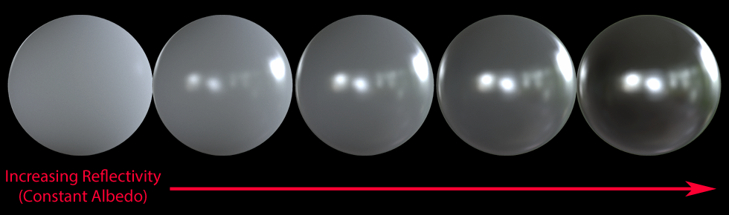
Physically Based Rendering
Energy Conservation
Energy Conservation
A surface cannot reflect more light than it receives!
https://www.marmoset.co/posts/basic-theory-of-physically-based-rendering/

Slide 24
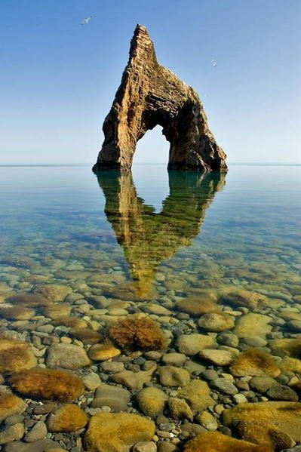
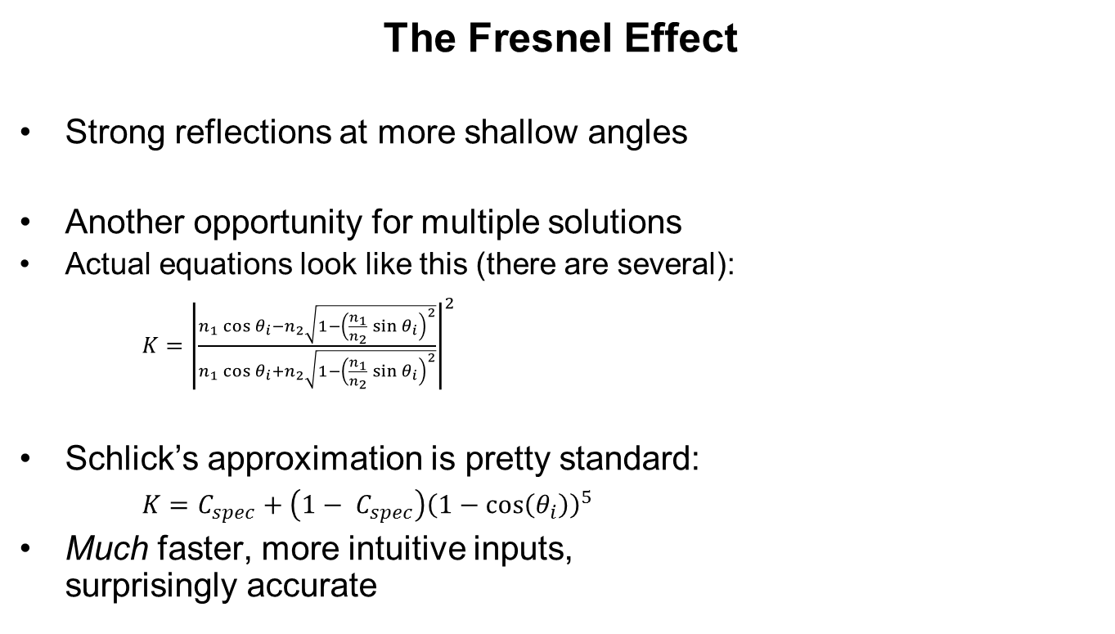
Physically Based Rendering
The Fresnel Effect
Strong reflections at more shallow angles
Another opportunity for multiple solutions
Actual equations look like this (there are several):
$K={\left|\frac{n_{1}\cos{θ_{i}}−n_{2}\sqrt{1−{\left(\frac{n_{1}}{n_{2}}\sin{θ_{i}}\right)}^{2}}}{n_{1}\cos{θ_{i}}+n_{2}\sqrt{1−{\left(\frac{n_{1}}{n_{2}}\sin{θ_{i}}\right)}^{2}}}\right|}^{2}$
Schlick’s approximation is pretty standard:
$K=C_{spec}+\left(1− C_{spec}\right){\left(1−\cos\left(θ_{i}\right)\right)}^{5}$
Much faster, more intuitive inputs, surprisingly accurate
https://www.pinterest.co.uk/pin/333407178635482154/

Slide 25
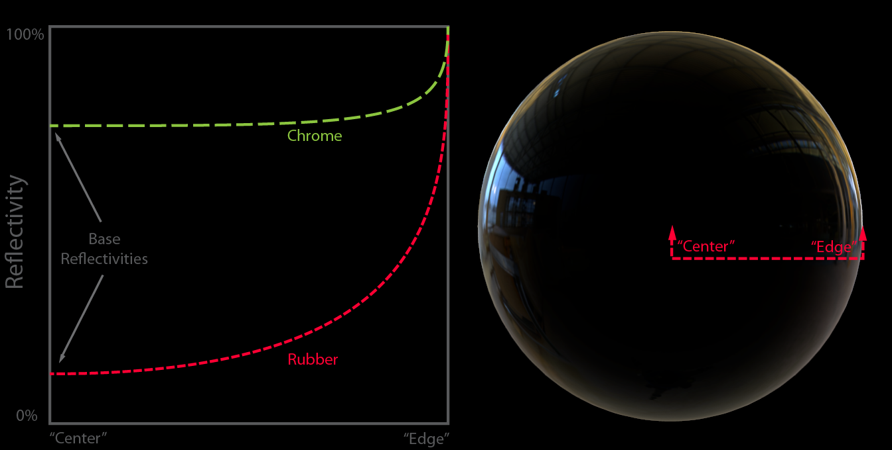
Physically Based Rendering
The Fresnel Effect
Another diagram:
https://www.marmoset.co/posts/basic-theory-of-physically-based-rendering/

Slide 26
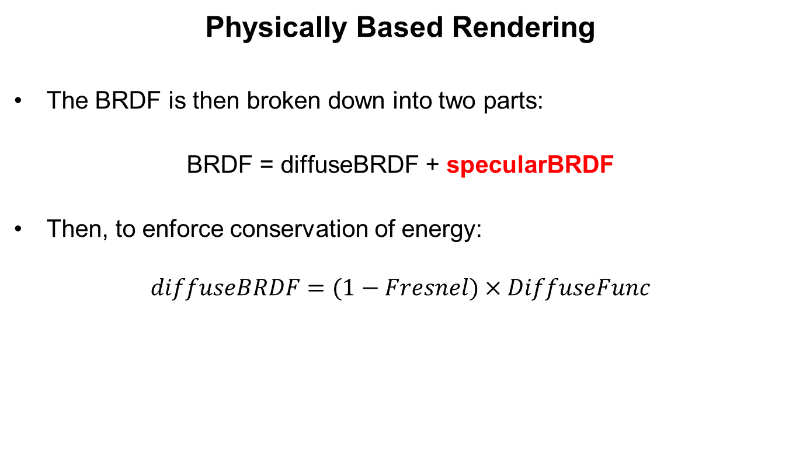
Physically Based Rendering
Physically Based Rendering
The BRDF is then broken down into two parts:
BRDF = diffuseBRDF + specularBRDF
Then, to enforce conservation of energy:
$$diffuseBRDF=(1−Fresnel)×DiffuseFunc$$

Slide 27
Physically Based Rendering
Physically Based Rendering
The real fun starts with the Specular BRDF
Each microfacet has its own surface normal
They can also get in the way of each other
These statements lead to two equation terms:
Distribution Term
Describes how the microfacet normals are distributed around a given direction
Geometry Term
Describes how much light is lost by facets occluding each other from the light source and the towards the viewer

Slide 28
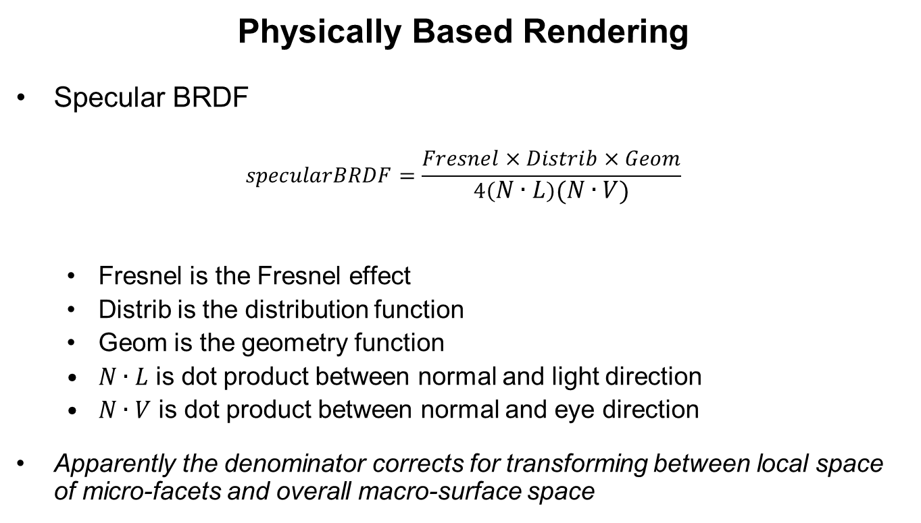
Physically Based Rendering
Physically Based Rendering
Specular BRDF
$$specularBRDF=\frac{Fresnel×Distrib×Geom}{4\left(N∙L\right)\left(N∙V\right)}$$
Fresnel is the Fresnel effect
Distrib is the distribution function
Geom is the geometry function
$N∙L$ is dot product between normal and light direction
$N∙V$ is dot product between normal and eye direction
Apparently the denominator corrects for transforming between local space of micro-facets and overall macro-surface space

Slide 29
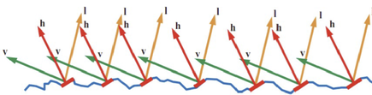
Physically Based Rendering
Physically Based Rendering
Some diagrams to help:
Distribution Term
Describes how the microfacet normals are distributed around a given direction
Basically, what proportion of microfacets are pointing in the direction of interest
http://wiki.ktxsoftware.com/Physically-Based-Rendering.html

Slide 30
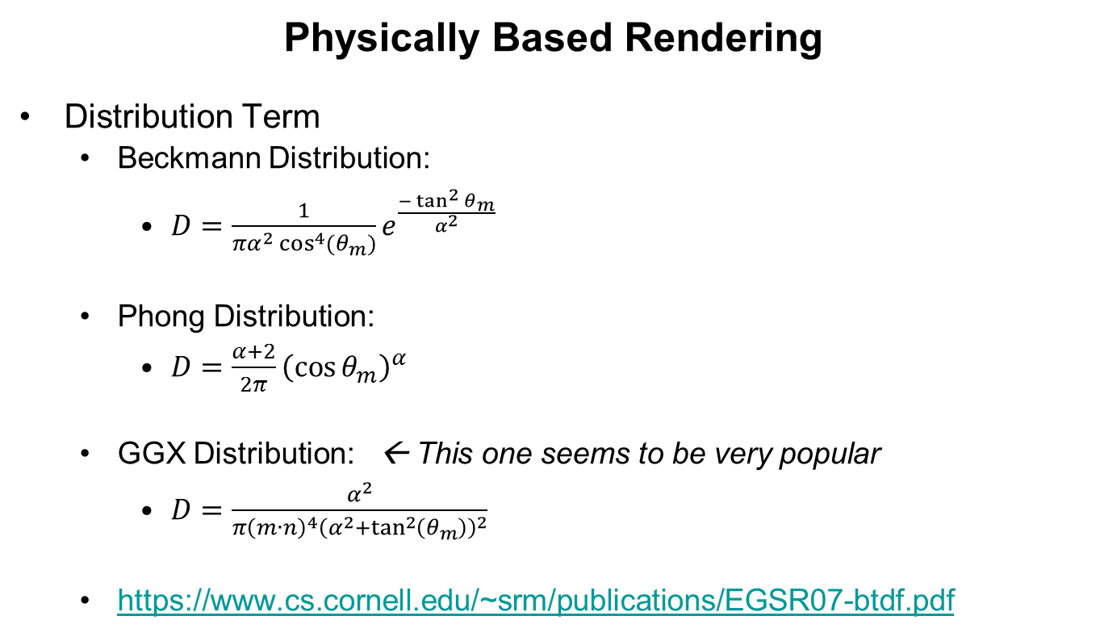
Physically Based Rendering
Physically Based Rendering
Distribution Term
Beckmann Distribution:
$D=\frac{1}{πα^{2}\cos^{4}{(θ_{m})}}e^{\frac{−\tan^{2}{θ_{m}}}{α^{2}}}$
Phong Distribution:
$D=\frac{α+2}{2π}{\left(\cos{θ_{m}}\right)}^{α}$
GGX Distribution: ← This one seems to be very popular
$D=\frac{α^{2}}{π{\left(m∙n\right)}^{4}{\left(α^{2}+\tan^{2}\left(θ_{m}\right)\right)}^{2}}$
https://www.cs.cornell.edu/~srm/publications/EGSR07-btdf.pdf

Slide 31

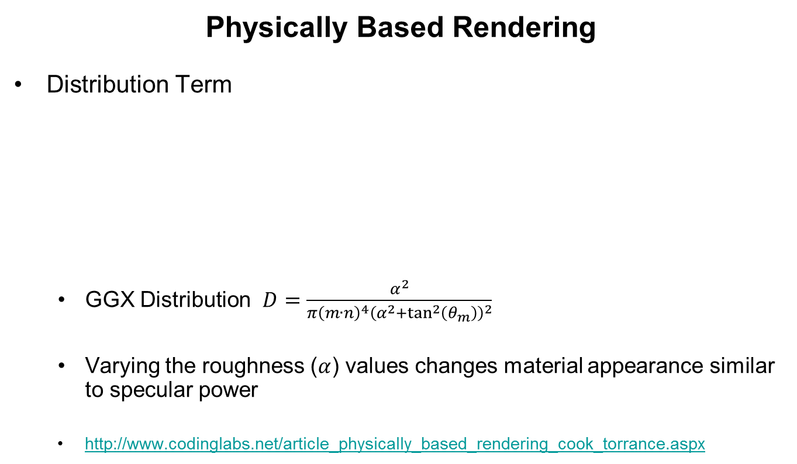
Physically Based Rendering
Physically Based Rendering
Distribution Term
GGX Distribution $D=\frac{α^{2}}{π{\left(m∙n\right)}^{4}{\left(α^{2}+\tan^{2}\left(θ_{m}\right)\right)}^{2}}$
Varying the roughness ($α$) values changes material appearance similar to specular power
http://www.codinglabs.net/article_physically_based_rendering_cook_torrance.aspx

Slide 32
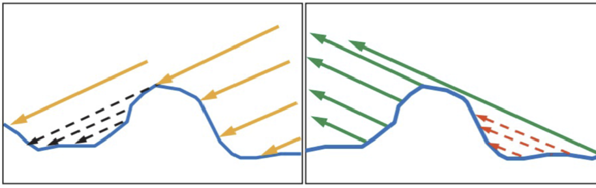
Physically Based Rendering
Physically Based Rendering
Some diagrams to help:
Geometry Term
Describes how much light is lost by facets occluding each other from the light source and towards the viewer
Basically, the proportion of light that is not lost due to facet visibility
http://wiki.ktxsoftware.com/Physically-Based-Rendering.html

Slide 33
Physically Based Rendering
Physically Based Rendering
Geometry Term
Actually derived from the distribution term
Must get ones that match
General form performs same function with view then light directions:
FinalGeom = Geom( eyeDir ) * Geom( lightDir )
Another source of confusion:
Some G functions cancel out the specular BRDF’s denominator, so this ends up dropped from the main specular term (rather than computing and cancelling)

Slide 34
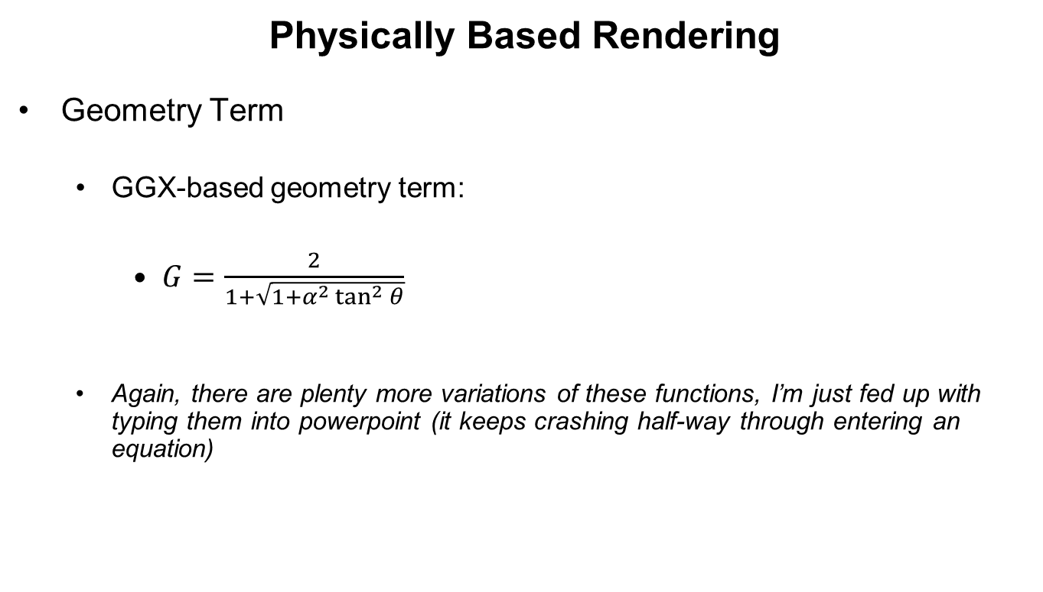
Physically Based Rendering
Physically Based Rendering
Geometry Term
GGX-based geometry term:
$G=\frac{2}{1+\sqrt{1+α^{2}\tan^{2}{θ}}}$
Again, there are plenty more variations of these functions, I’m just fed up with typing them into powerpoint (it keeps crashing half-way through entering an equation)

Slide 35
Physically Based Rendering
Physically Based Rendering
Another source of confusion – where to get the input parameters from??
Key material input parameters:
Diffuse: Albedo (diffuse reflection colour with no ambient occlusion)
Fresnel: $F\left(0°\right)$ (reflectivity level from above the macro-surface normal)
Geometry and Distribution: roughness
Some implementations have an input for ‘metalness’, which is a binary option between conductor / dielectric
This isn’t necessarily needed if you understand the effect on albedo and $F\left(0°\right)$

Slide 36
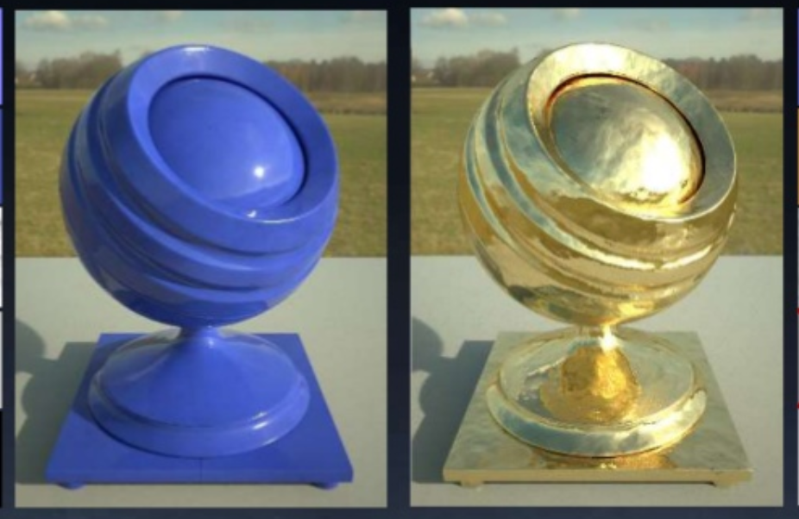
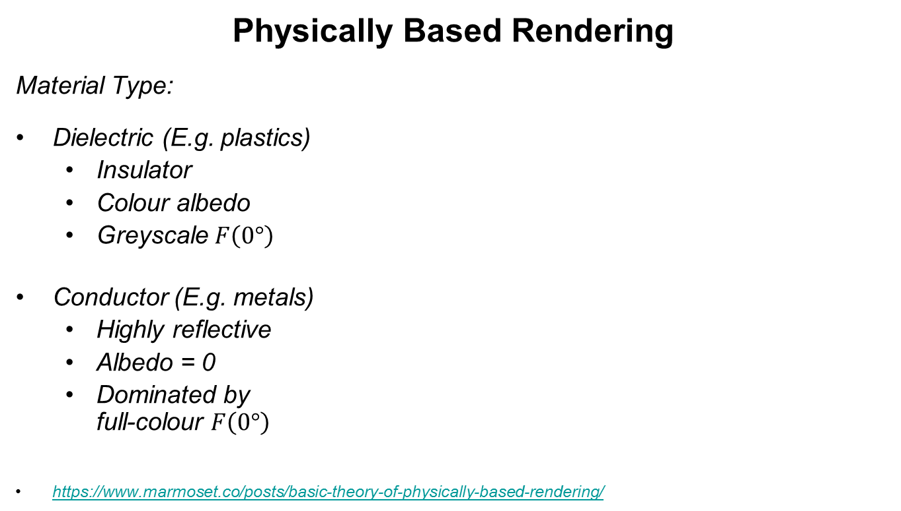
Physically Based Rendering
Physically Based Rendering
Material Type:
Dielectric (E.g. plastics)
Insulator
Colour albedo
Greyscale $F\left(0°\right)$
Conductor (E.g. metals)
Highly reflective
Albedo = 0
Dominated by full-colour $F\left(0°\right)$
https://www.marmoset.co/posts/basic-theory-of-physically-based-rendering/

Slide 37
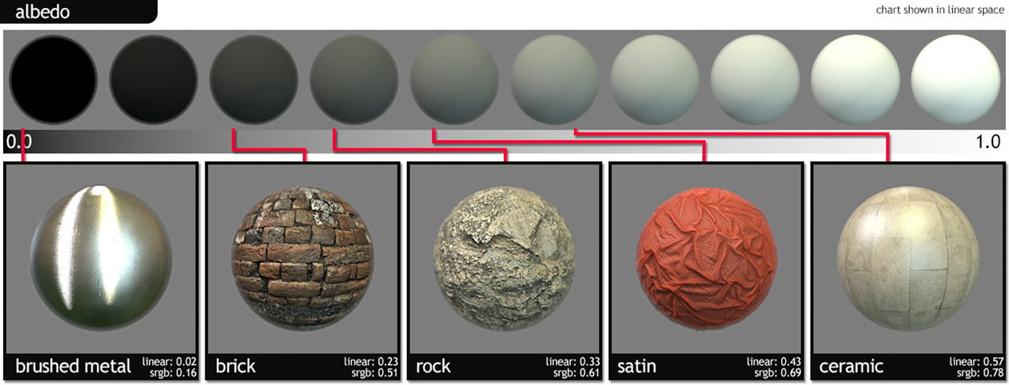
Physically Based Rendering
Physically Based Rendering
Albedo – like diffuse colour, but with no baked-in lighting. Like diffuse under white light
For conductors, albedo is zero; for dielectrics, albedo is full colour
https://www.marmoset.co/posts/physically-based-rendering-and-you-can-too/

Slide 38
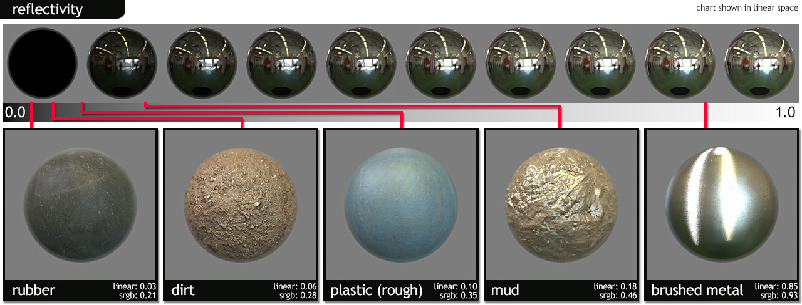

Physically Based Rendering
Physically Based Rendering
$F\left(0°\right)$ is the characteristic specular reflectance of the material
Like a PBR specular colour
Literally, the specular component of the colour that is reflected by pure white light at an angle of $0°$ above the surface
https://www.marmoset.co/posts/physically-based-rendering-and-you-can-too/

Slide 39
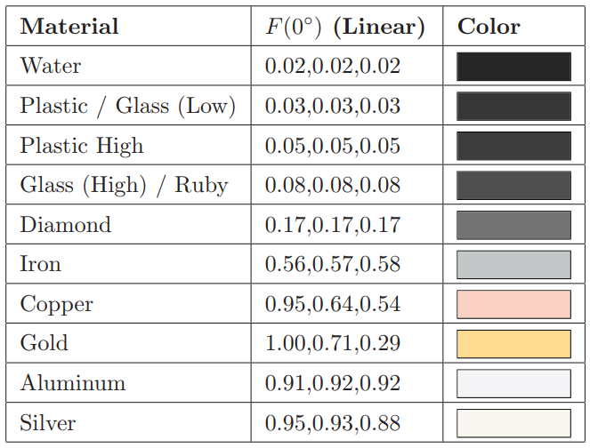

Physically Based Rendering
Physically Based Rendering
We must look $F\left(0°\right)$ up from measurements of real materials
Dielectrics have low values and are in greyscale
Diamond is highly reflective, but only reflects 17%!!
Conductors have high values and in full colour
Iron is a very dull metal, but reflects 50% of light!!

Slide 40
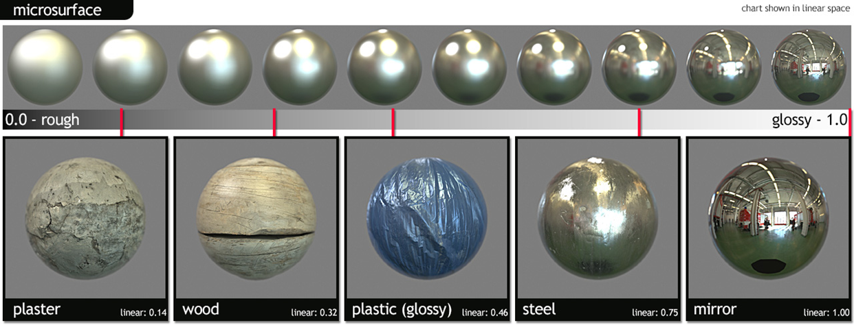
Physically Based Rendering
Physically Based Rendering
Roughness is much more straightforward
Look at comparable objects and set by the artist
https://www.marmoset.co/posts/physically-based-rendering-and-you-can-too/

Slide 41
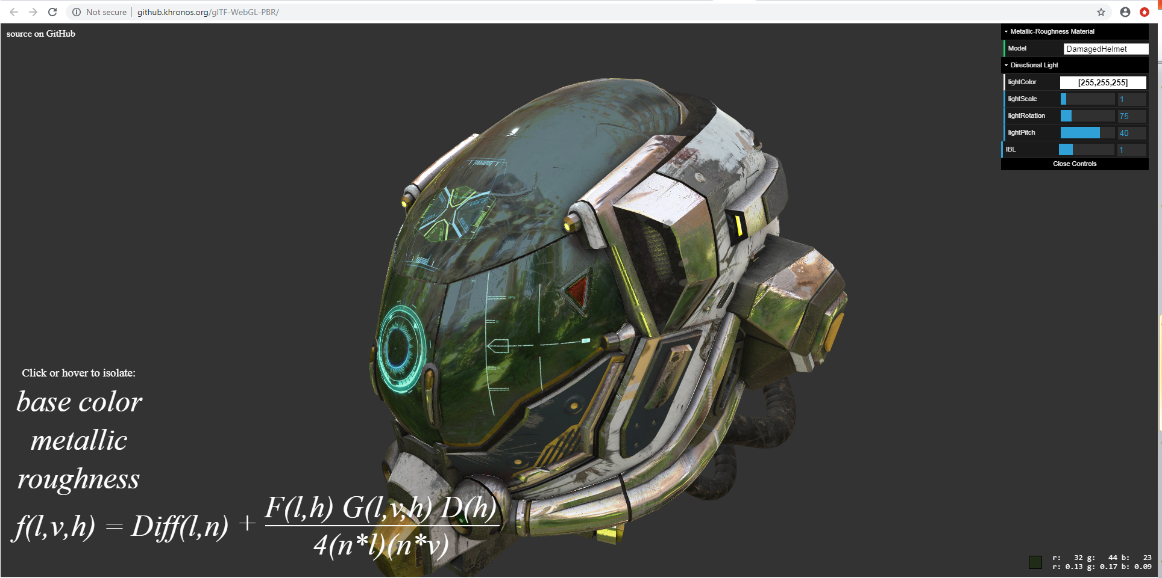
Conflicting Methods
Physically Based Rendering
Live demo with equation breakdown here: http://github.khronos.org/glTF-WebGL-PBR/

Slide 42
Conflicting Methods
Physically Based Rendering
When in doubt, try to find some source-code
https://seblagarde.files.wordpress.com/2015/07/course_notes_moving_frostbite_to_pbr_v32.pdf
Good source: (EA) Frostbite engine
Good explanations, diagrams, equations + source code
https://github.com/KhronosGroup/glTF-WebGL-PBR
Good source: Kronos glTF (3D scene format)
Good explanations + source code

Slide 43
Conflicting Methods
Physically Based Rendering
Useful PBR references:
https://disney-animation.s3.amazonaws.com/library/s2012_pbs_disney_brdf_notes_v2.pdf
https://seblagarde.wordpress.com/2013/04/29/memo-on-fresnel-equations/
https://www.cs.virginia.edu/~jdl/bib/appearance/analytic%20models/schlick94b.pdf
http://www.codinglabs.net/article_physically_based_rendering_cook_torrance.aspx
http://simonstechblog.blogspot.com/2011/12/microfacet-brdf.html
http://renderwonk.com/publications/s2010-shading-course/hoffman/s2010_physically_based_shading_hoffman_a_notes.pdf

